Slide 1

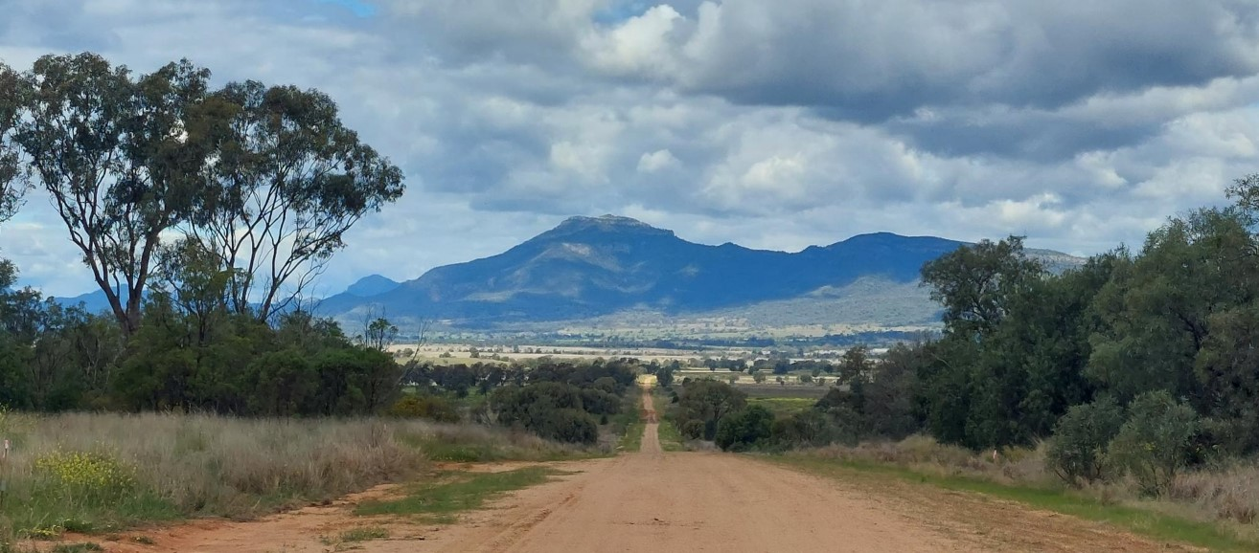
Tooraweenah Road Upgrade
Coonamble Shire Council

Slide 2
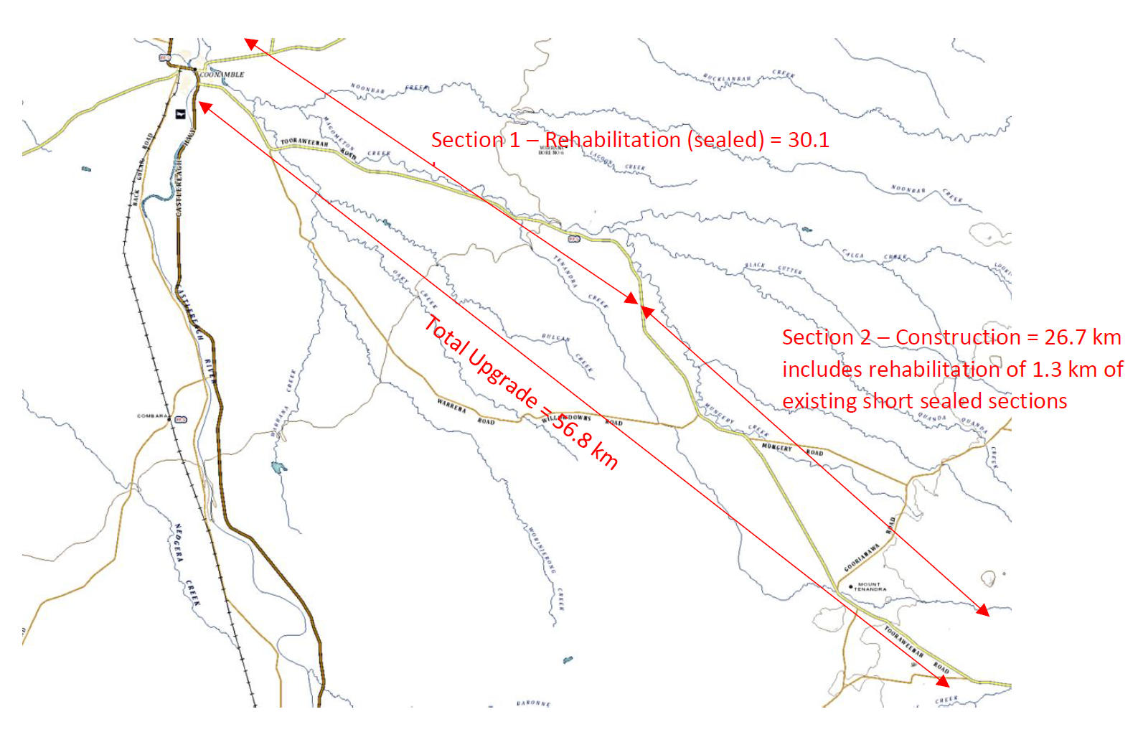
Project Details
Tooraweenah Rd is the most direct route between Coonamble and the Warrumbungle.
The upgrade commences from the eastern outskirts of Coonamble and continues to the border of the Gilgandra Shire Council
The road traverses a flood plain, black soils and poor subgrade and is not suitable for the heavy vehicles that currently traverse it.
The road is 56.8km long with a 30.1km sealed pavement of varying width; and 26.7km of unsealed earthen formation ave width 7m.
Most of the sealed section requires rehab, the unsealed section requires upgrading and sealing.

Slide 3
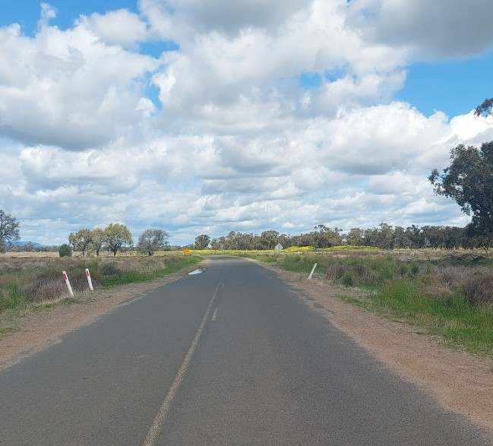
PROJECT BENEFITS
Improved travel times
Lower vehicle operating costs
Enhanced tourist use of the Tooraweenah Road. The unsealed section is a deterrent to non-locals
Increased productivity for business – in particular the existing and proposed quarries on Tooraweenah Road.
Improved road safety

Slide 4

PROJECT SCOPE
Aims to provide 56.8km of road with a 9.9m wide pavement and 7.5m seal with guideposts, centreline and edge marking.
Flooding immunity
Improve access to prime agricultural land
Improve access to existing and proposed quarries on Tooraweenah Road
Improved access for tourists to the Warrumbungle National Park.

Slide 5
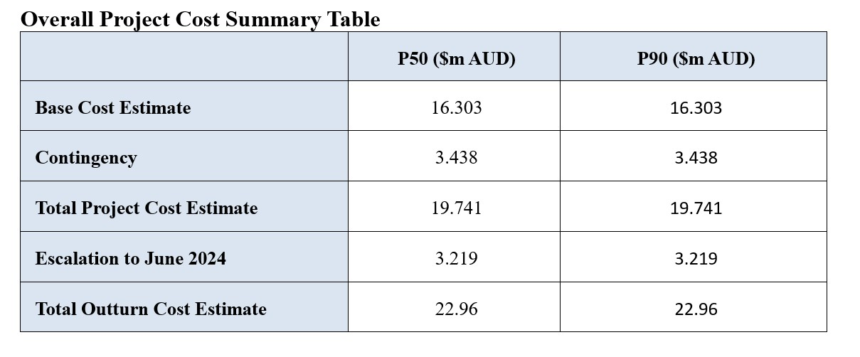
PROJECT COSTS
A base estimate was prepared in December 2018 using the unit rates estimating method.
This method calculates the quantity of each item of the project by multiplying the quantity of work by historical unit rates obtained from previous projects.
The overall project cost estimate is $22.96M.
The project is 100% Federal Government funded.

Slide 6
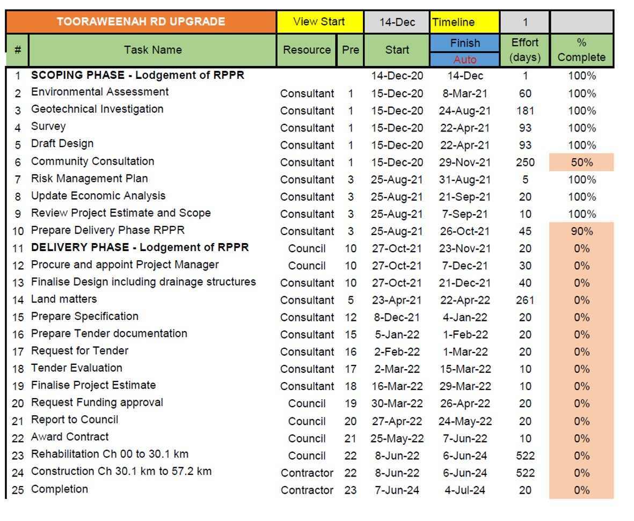
PROJECT TIMELINE

Slide 7
RISK & SUSTAINABILITY
The following have been identified as risks for the project and their mitigation strategies:
Project cost exceeds budget – use contractors and refining the rehabilitation works on the sealed section
Market saturation impacts contractor availability – flexible delivery options,
Road subgrade conditions worse than originally identified
Environmental issues encountered during construction not identified in the REF
Wet weather during construction
Flooding risks
Covid 19
Road pavement encroachments
Inadequate resources
Inadequate scoping of project during development

Slide 8

STAKEHOLDER ENGAGEMENT
Council has consulted with the community regarding the project through the preparation of its Integrated Reported and Planning community engagement processes, and various reports to Council. There is unanimous support for the project.
Landowners, Environmental consultants are to be consulted; signage and public notification to advise of construction. All residents and landowners will be advised by letter.

Slide 9

COMPLIANCE
Legislation that applies to the project:
Roads Act 1993 (NSW)
Local Government Act 1993 (NSW)
NSW Environmental Planning and Assessment Act 1979 (NSW)
State Environmental Planning Policy (Infrastructure) 2007 (ISEPP) NSW
Biodiversity Conservation (BC) Act 2016 (NSW)
National Parks and Wildlife (NP&W) Act 1979 (NSW)
Biosecurity Act 2015 (NSW)
The Work Health and Safety (WHS) Act 2011
The Heritage Act 1997 (NSW)

Slide 10
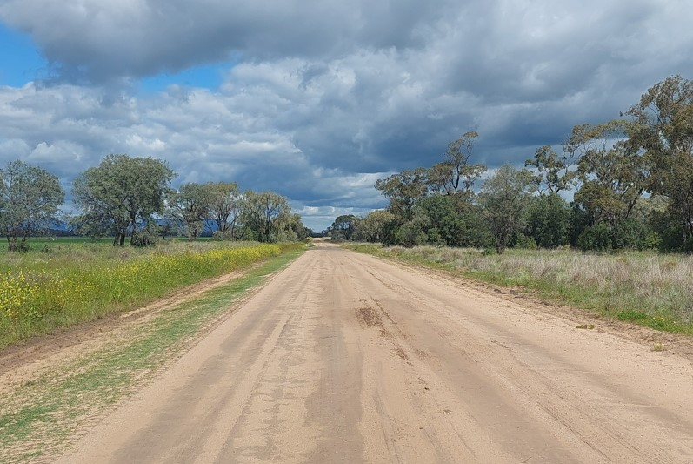
QUESTIONS?

